Slide 1



Credit Card Fraud Detection
Sashidhar Bezawada

Slide 2
Agenda
Introduction
Dataset & Source
Data Transformation
Exploratory Data Analysis
Risks / Contingencies
Models & Metrics
Result Interpretation
Conclusion
Ethical Considerations
References

Slide 3

Introduction
Credit Card Frauds are the cases of using someone else's credit cards for financial transactions without the information of the card owner.
Global economy pays the price of more than $ 24 billion per year due to these frauds. It is important that credit card companies are able to recognize fraudulent credit card transactions so that customers are not charged for items that they did not purchase.
Business Problem :
Develop a machine learning model to classify whether a credit card transaction is fraudulent or genuine and handle unbalanced dataset.
Notes:
Credit Card Frauds are the cases of using someone else's credit cards for financial transactions without the information of the card owner. Credit Cards were made available in order for the people to increase their buying power, it is an agreement with your bank that lets the user use the money lended by the bank in exchange for the repayment of this lended money on the due date or incur interest charges. As all the things in the nature are binary, cases of credit card frauds have also achieved high numbers. Global economy pays the price of more than $ 24 billion per year due to these frauds. It is important that credit card companies are able to recognize fraudulent credit card transactions so that customers are not charged for items that they did not purchase. Thus, it becomes essential to solve this problem and building automated models for such a rising problem statement is necessary and AI - ML is the key for it!

Slide 4
Dataset & Source
The dataset contains transactions made by credit cards in September 2013 by European cardholders.
creditcard.csv - This dataset presents transactions that occurred in two days, where we have 492 frauds out of 284,807 transactions. The dataset is highly unbalanced, the positive class (frauds) account for 0.172% of all transactions. It contains only numerical input variables which are the result of a PCA transformation.
Dataset Attributes :
V1 - V28 : Numerical features that are a result of PCA transformation.
Time : Seconds elapsed between each transaction and the 1st transaction.
Amount : Transaction amount.
Class : Fraud or otherwise (1 or 0)
Dataset : https://www.kaggle.com/datasets/mlg-ulb/creditcardfraud/data

Slide 5

Exploratory Data Analysis

Slide 6
Data Transformation
Removed 1081 duplicates from the dataset.
Has no missing values and no Categorical value.
Data types are all float values excluding the target (integer).
There are too many features in the dataset and it is difficult to understand anything. Hence, we will plot the correlation map only with the target variable.
Feature reduction has been performed in two ways:
Based on Correlation Plot : ( 10 columns considered )
For feature selection, we will exclude the features having correlation values between [-0.1,0.1].
V4, V11 are positively correlated and V7, V3, V16, V10, V12, V14, V17 are negatively correlated with the Class feature.
Based on ANOVA Score : ( 21 columns considered )
Higher the value of the ANOVA score, higher the importance of that feature with the target variable. And have rejected features with values less than 50.

Slide 7
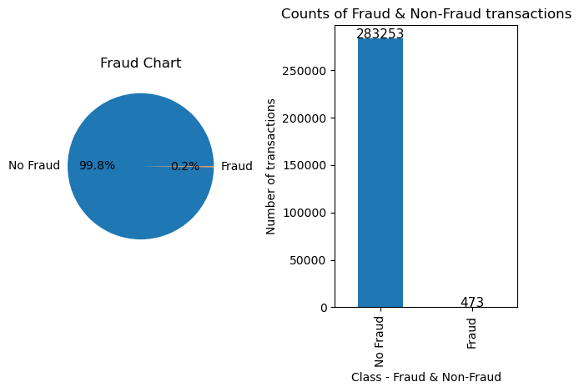
Data Visualizations
Notes:
The data is clearly highly unbalanced with majority of the transactions being No Fraud. And the classification model will bias its prediction towards the majority class, No Fraud.
Hence, data balancing is required for building a robust model.

Slide 8
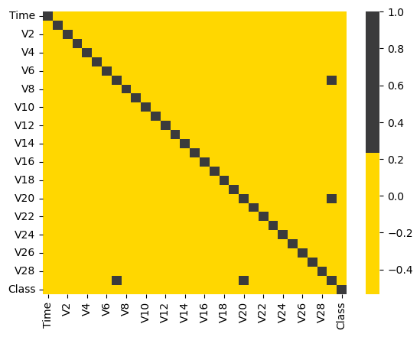
Data Visualizations
Notes:
There are too many features in the dataset and it is difficult to understand anything. Hence, we will plot the correlation map only with the target variable.

Slide 9
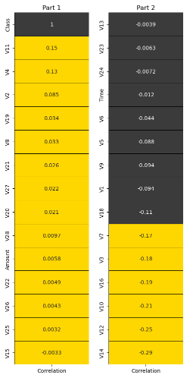
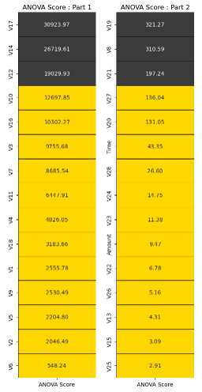
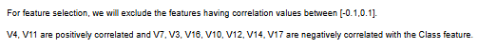
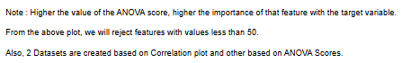
Data Visualizations

Slide 10
Risks / Contingencies
This is a simulated dataset and has only 31 attributes. This is an imbalanced dataset. To improve the effectiveness, SMOTE has been used.

Slide 11
Models
&
Metrics

Slide 12
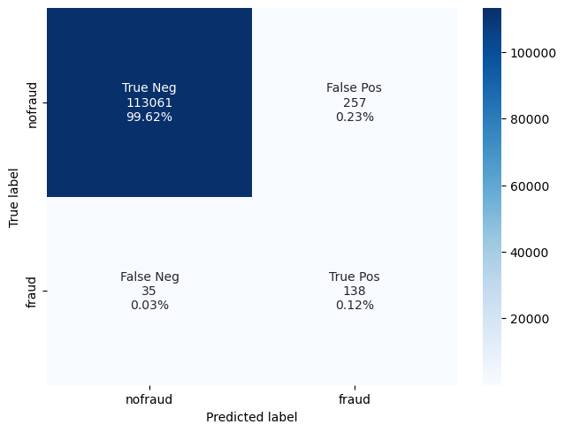

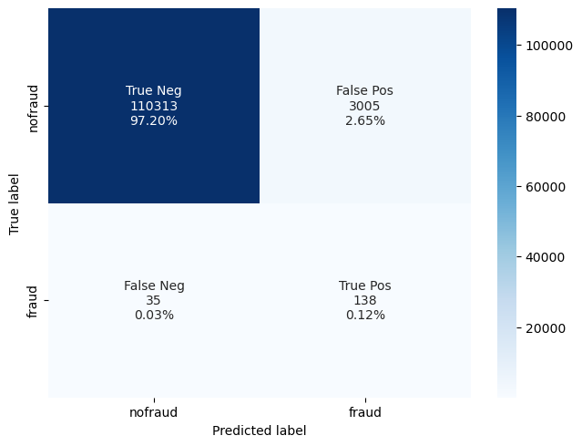


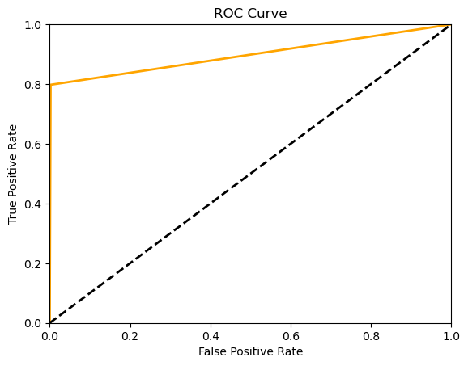
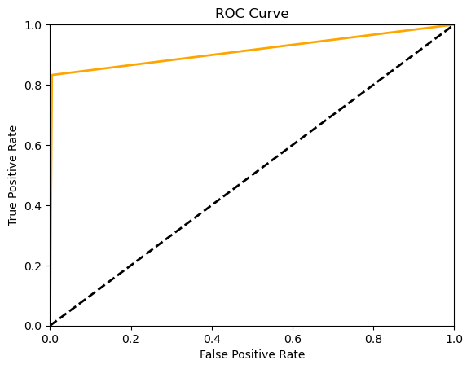
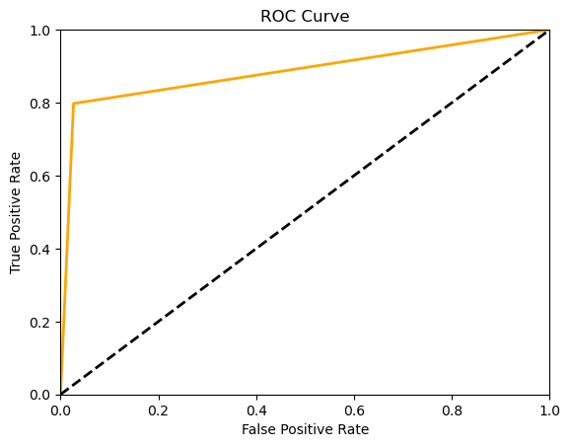
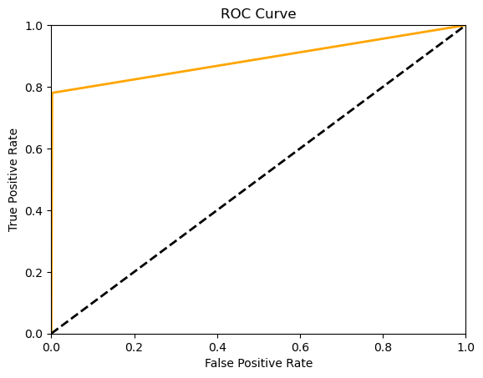
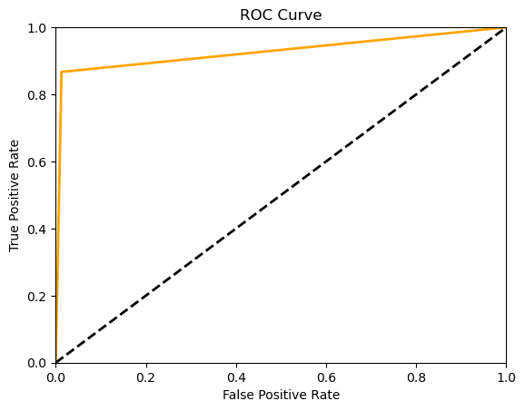
Models & Metrics - Correlation Plot
K-Nearest Neighbor
Random Forest Classifier
Decision Tree Classifier
XGBoost Model
Gradient Boosted Classifier
Notes:
Post-data exploration, the models were performed on all of the 31 features in the dataset. The model performance was then evaluated based on the models’ accuracies and confusion matrices. Precision and recall can be derived from a confusion matrix; recall helps to determine the ability to find all relevant instances of a class in a data set, whereas precision is used to determine the proportion of data points that the model says exists within the relevant class were indeed relevant.
The F1 score is calculated as the harmonic mean of precision and recall. The AUC measures the probability that the model will assign a randomly chosen positive instance a higher predicted probability compared to a randomly chosen negative instance. All accuracy, precision, recall, F1-Score, AUC results can be viewed in the Summary Slide.
This Side shows the Confusion matrix and ROC curve for the models with the dataset created using Correlation Plot

Slide 13






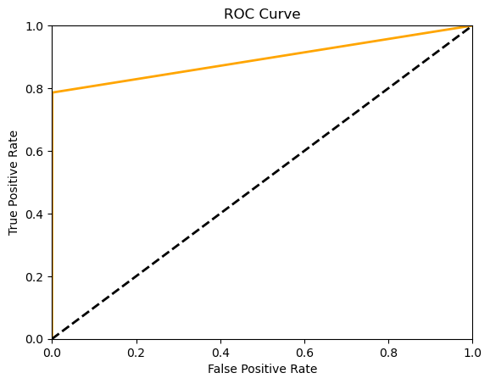
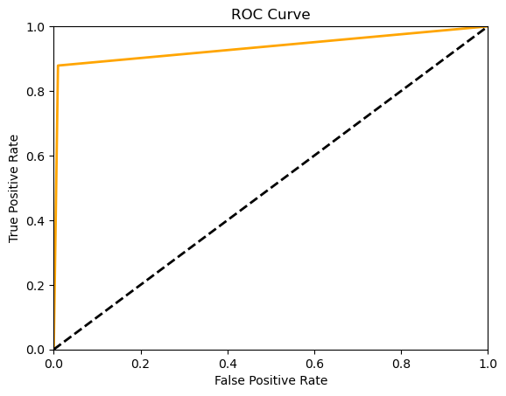
Models & Metrics - ANOVA Score
K-Nearest Neighbor
Random Forest Classifier
Decision Tree Classifier
XGBoost Model
Gradient Boosted Classifier
Notes:
This Side shows the Confusion matrix and ROC curve for the models with the dataset created using ANOVA Score

Slide 14
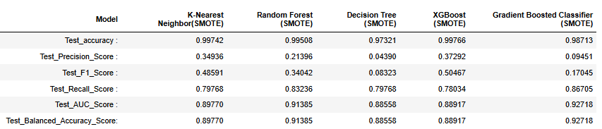
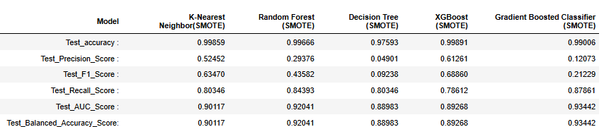
Models & Metrics - Summary
Model Results based on Correlation Plot :
XGBoost - Accuracy is highest as well as it is identifying the Fraud better with the Highest Precision Score).
Also, it has high Recall & F1 Scores.
Model Results based on ANOVA Score :

Slide 15
Result Interpretation
SMOTE uses a nearest neighbors algorithm to generate new and synthetic data we used for training our model.
Decision Tree - Model accuracy and Precision is the lowest among the 5 Models.
K-Nearest Neighbor - Has good Accuracy Score, and 2nd highest F1 and Recall Scores. The False positive & False negative cases are higher than all models.
Random Forest - Accuracy score is good, however the model is not predicting the Fraud correctly (precision is low).
XGBoost - Accuracy is highest as well as it is identifying the Fraud better with the Highest Precision Score). Also, it has high Recall & F1 Scores.
Gradient Boosted Classifier - Accuracy is high. While precision is low. It also has the highest Recall, F1 & AUC Scores.
Also, The Scores are higher with feature reduction done with ANOVA test than Correlation plot.

Slide 16
Conclusion
A great dataset to learn about binary classification problem with unbalanced data.
All models achieved very high accuracy on the test data. However, it's essential to keep in mind that accuracy might not be the best evaluation metric for imbalanced datasets like the one in this case. Since fraudulent transactions are rare, a high accuracy score can be misleading, as a model could simply predict all transactions as non-fraudulent and still achieve a high accuracy due to the class imbalance.
In such cases, metrics like precision, recall, F1-score, or the area under the precision-recall curve (AUPRC) are more informative for evaluating model performance. These metrics provide insights into how well the model performs specifically on identifying fraudulent transactions.
Notes:
This is a great dataset to learn about binary classification problem with unbalanced data. As the features are disguised, feature selection cannot be assisted based on the domain knowledge of the topic. Statistical tests hold the complete importance to select features for modeling.
It appears that all models achieved very high accuracy on the test data. However, it's essential to keep in mind that accuracy might not be the best evaluation metric for imbalanced datasets like the one in this case. Since fraudulent transactions are rare, a high accuracy score can be misleading, as a model could simply predict all transactions as non-fraudulent and still achieve a high accuracy due to the class imbalance. In such cases, metrics like precision, recall, F1-score, or the area under the precision-recall curve (AUPRC) are more informative for evaluating model performance. These metrics provide insights into how well the model performs specifically on identifying fraudulent transactions.

Slide 17
Ethical Considerations
Bias : Models can be programmed to favor certain groups of people over others. This can lead to unfair treatment and discrimination, kind of like a robot referee who always calls fouls against one team but not the other.
Privacy : It's important to make sure that this data is used in a way that respects our privacy and autonomy, so we don't feel like we're constantly being watched by a robot spy.
Responsibility : If an model makes a mistake or causes harm, who is to blame? Is it the developer who created the system, the company that deployed it, or the robot itself? It's like a game of hot potato, but with ethical and legal implications.

Slide 18
References
https://www.kaggle.com/datasets/mlg-ulb/creditcardfraud
https://www.chargebackgurus.com/blog/credit-card-fraud-detection
https://www.cnbc.com/select/what-is-a-credit-card/
https://www.fortunebusinessinsights.com/industry-reports/fraud-detection-and-prevention-market-100231

Slide 19

THANK YOU

